Slide 1
Faculty of Mathematics and Physics
Charles University
Game User Experience
Lecture 6

Slide 2
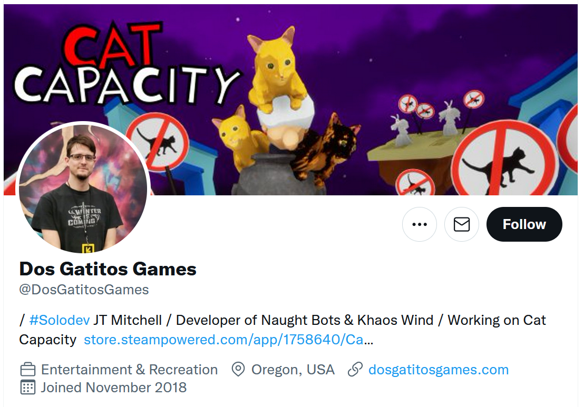
Onboarding

Slide 3
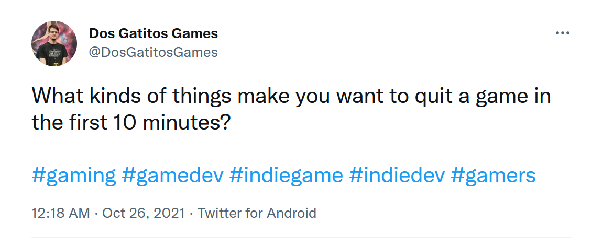
Onboarding

Slide 4
Shared Document
Let‘s go to the g-doc https://docs.google.com/spreadsheets/d/1S224KOCIWKzA_WloW1wx3kx8IBXlc33VQ1ihAeZIDoY/edit?usp=sharing
(Link in the Discord)

Slide 5
Limits of our data
Selection bias & Response bias
Notes:
It is a developers account – I am collecting data only from a certain population – probably gamers, somehow focused on some types of games
Response bias - where there’s something about how the actual survey questionnaire is constructed that encourages a certain type of answer, leading to measurement error.

Slide 6
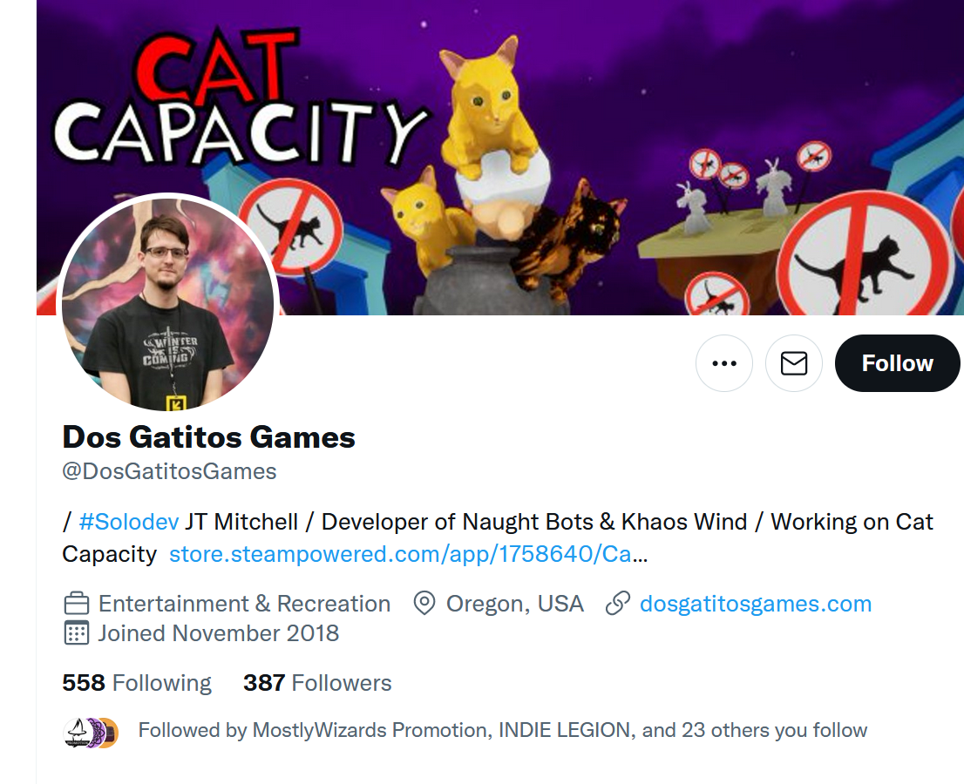
Sampling Bias
1. Sampling Bias
2. Non-response Bias

Slide 7
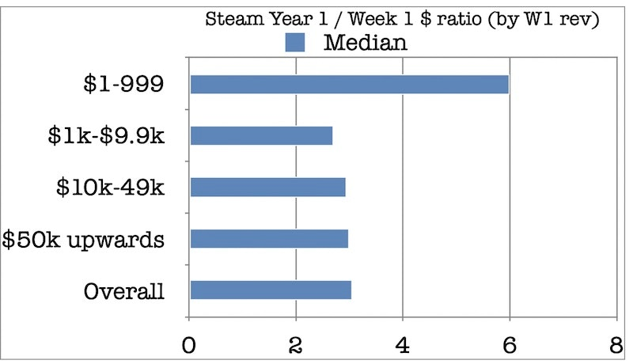
Survivorship bias
Source:
The GameDiscoverCo (2021)

Slide 8
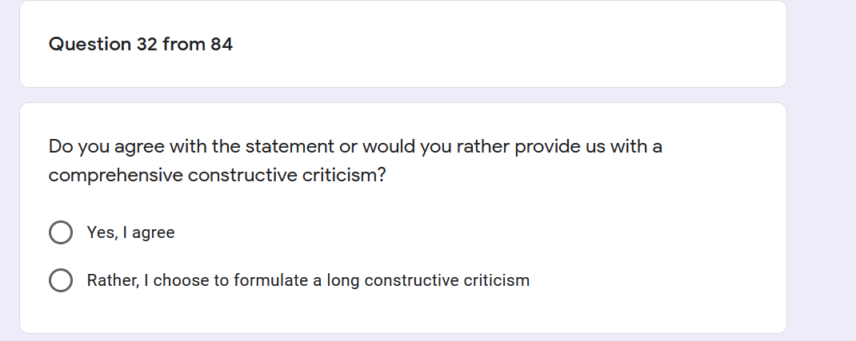
Yes-man Bias

Slide 9
Question Order Bias
1. How do you evaluate the game? 2. What did you dislike about the game mechanics?

Slide 10
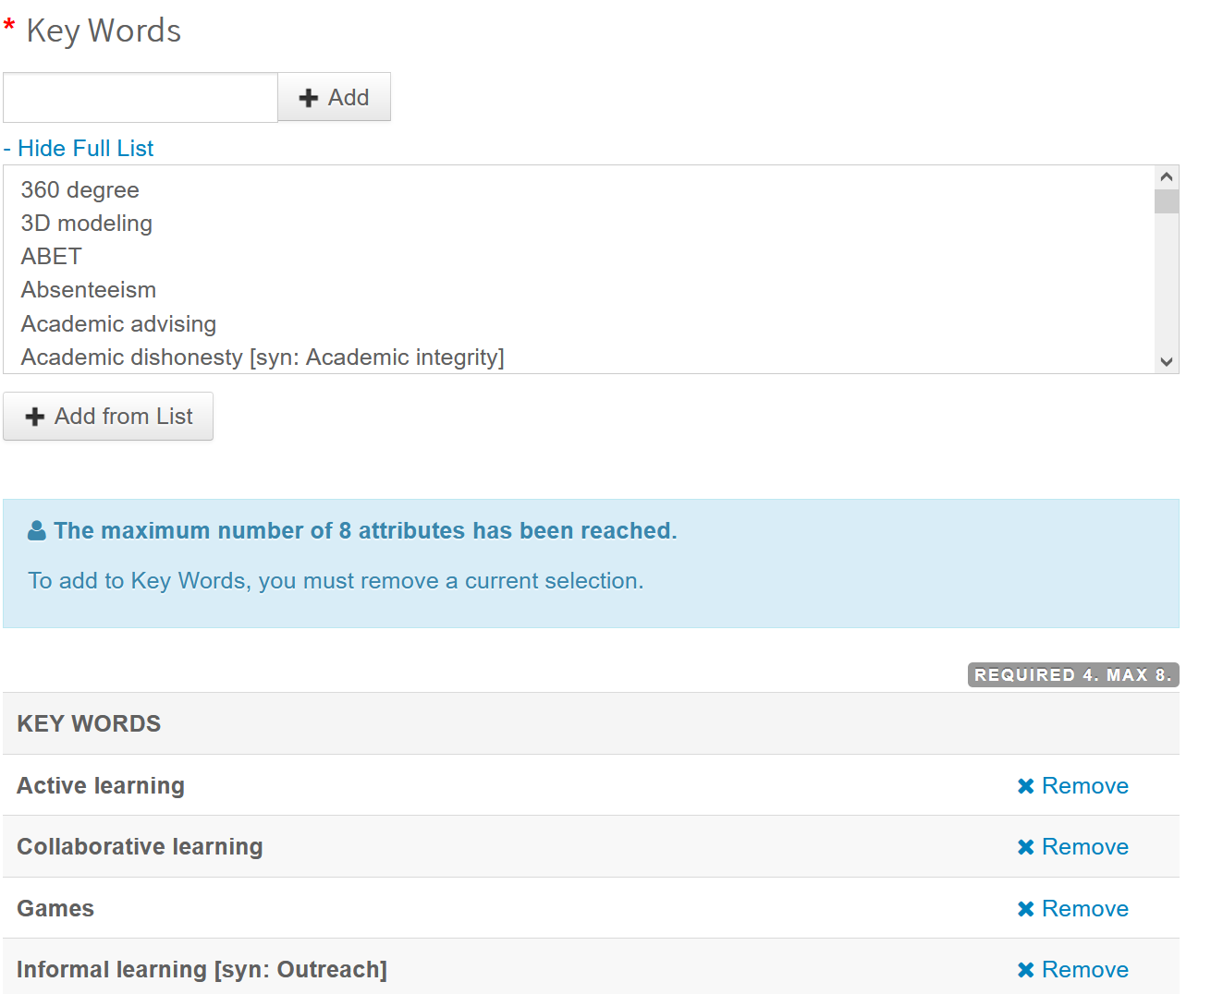
Options Order Bias

Slide 11
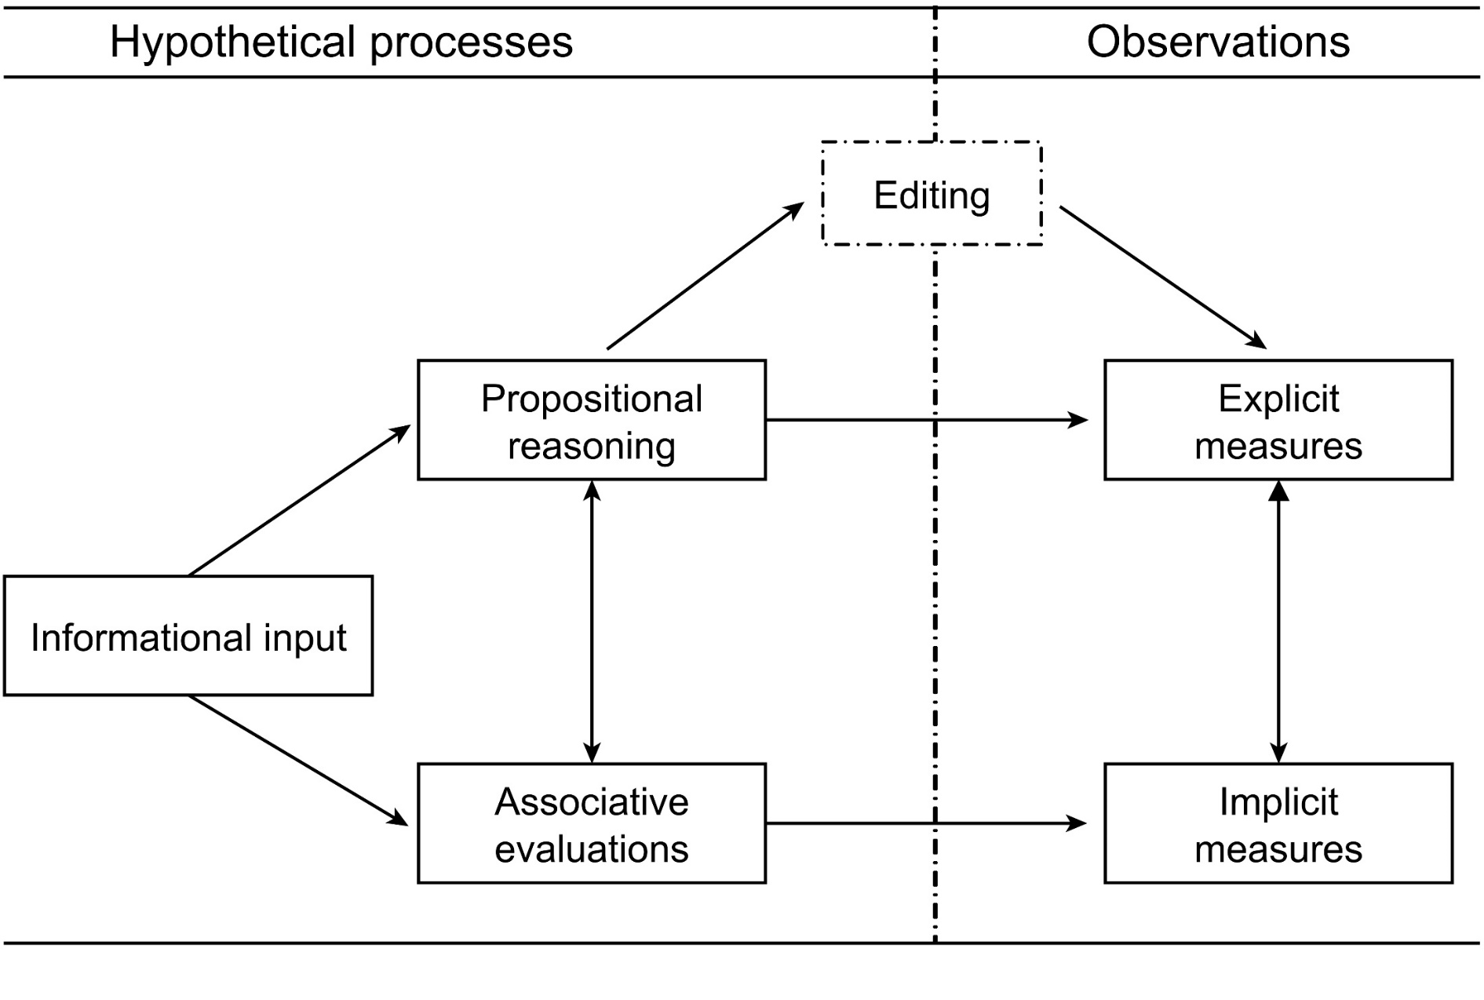
Social desirability or conformity bias

Slide 12
Tutorials
Video - Viva La Dirt League

Slide 13
Onboarding
Clear understanding of how things work before fully benefiting from the experience
Unique to each games

Slide 14
Hands-On
Clear understanding of how things work before fully benefiting from the experience
Unique to each games

Slide 15
Three general approaches
Walkthrough
Hands-on experience
Mixed approach

Slide 16
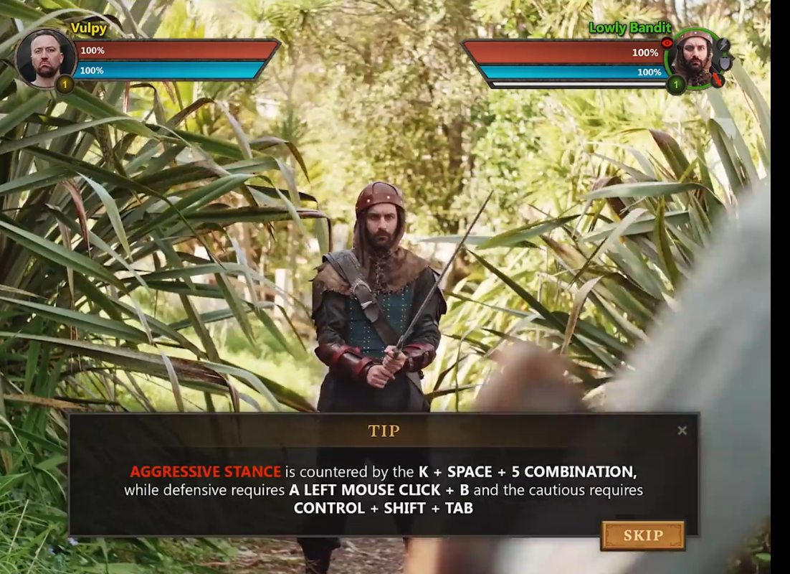
Walkthrough
Source:
Viva La Dirt League (2021)

Slide 17
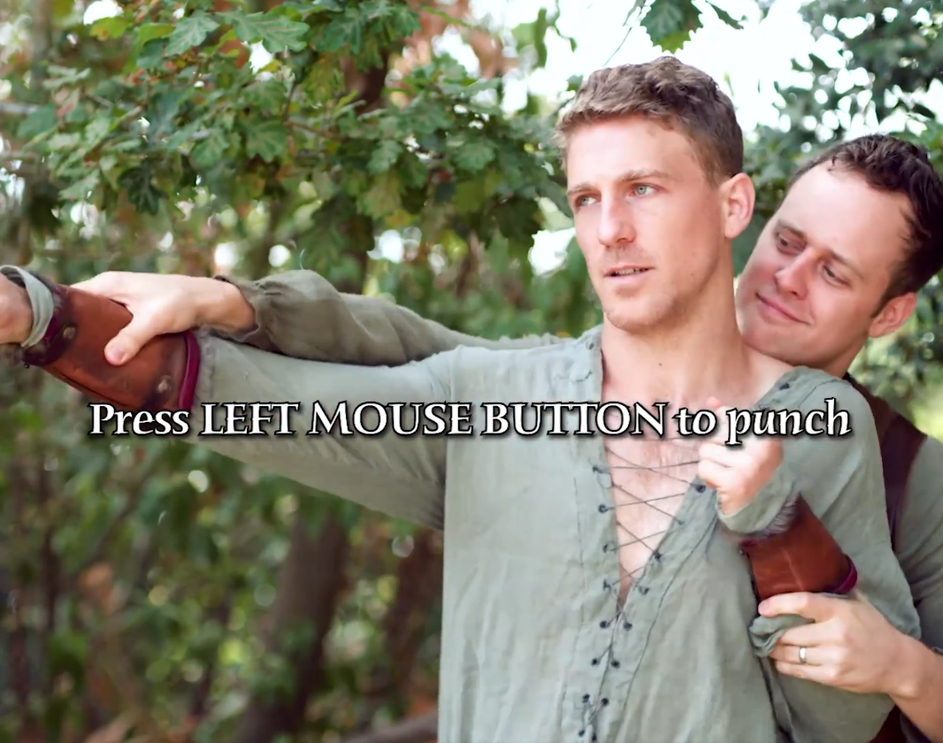
Hands-on
Source:
Viva La Dirt League (2021)

Slide 18
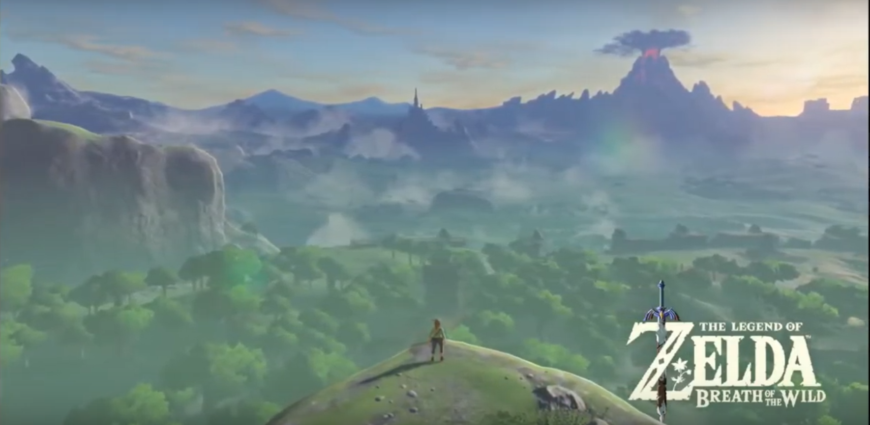
Mixed approach
The Legend of Zelda: Breath of the Wild (2017)

Slide 19
Faculty of Mathematics and Physics
Charles University
In case of questions:
kolek@ksvi.mff.cuni.cz
Stay in touch on Discord

